Slide 1
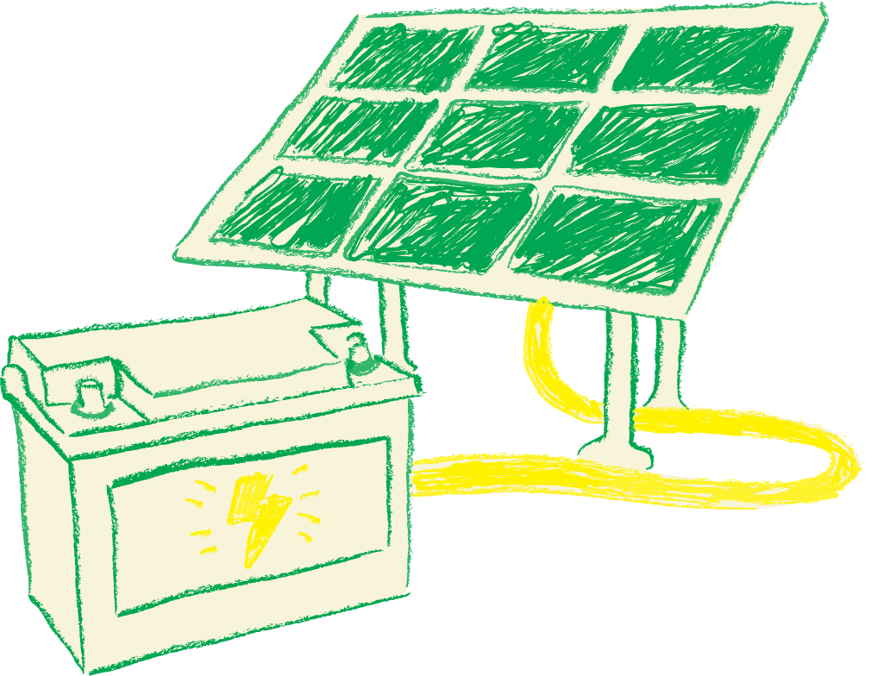
sust-AI-naible
Reducing Cloud Carbon with Multi-Agent AI
Members:
Sarthak
Pooja
Josue
IS492— Spring 2026
GitHub Repo Link:
https://github.com/IS492-SP26/team-project-carbon-emissions
Notes:
Hi, we're [names]. Our project is called sust-AI-naible. In one sentence:
existing tools tell companies how much carbon their cloud produces —
our system automatically reduces it and proves the reduction was real.
Here's why that matters."

Slide 2


Problem & Motivation
Cloud computing produces as much CO₂ as the entire airline industry
Human Pain
Engineers are asked to reduce cloud carbon
But tools only show past emissions
No system helps them act
Why Now?
CSRD (2025) mandates carbon reporting
AI workloads increasing energy demand
All major clouds launched carbon dashboards, but no automation
Who Feels It
Platform engineers
DevOps teams
Engineering leaders with sustainability KPIs
Notes:
Cloud computing produces about 1% of global CO₂ — that's comparable to all
commercial aviation. And it's growing fast because of AI workloads.
The human problem is simple: engineers are being told 'reduce our carbon footprint'
but the only tools they're given are dashboards. Dashboards that show them a number
went up last month. That's like telling someone to lose weight by staring at a scale.
This matters now because the EU literally requires large companies to report and
reduce their carbon starting 2025. Companies need tools that *do something*, not
just measure.

Slide 3


Target Users & Core Tasks
Platform Engineer
Engineering Leader
Developer
Task: Make workloads greener
Success: Jobs automatically shift to cleaner regions/times
Constraint: No SLA violations
Task: Prove reductions
Success: Auditable evidence chain
Constraint: Board-ready reporting
Task: Understand impact
Success: Team-level carbon receipts per deployment
Key insight: Most cloud workloads are time and location flexible
Notes:
"Three users. The platform engineer needs the system to actually *move things*, not
just show charts. The engineering leader needs numbers that survive an audit —
they're going in front of the board. And individual developers just want to know:
how does my team compare, and what can I do differently?
Here's the key insight behind everything: most cloud jobs — CI builds, training
runs, data pipelines — don't care where or when they run. They'll happily run in
Oregon at 3am instead of Virginia at 6pm. But Oregon's electricity is 75% cleaner
because it's powered by hydroelectric dams. Nobody moves these jobs. We do."

Slide 4



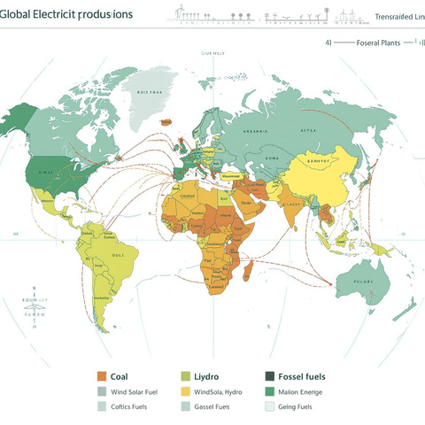
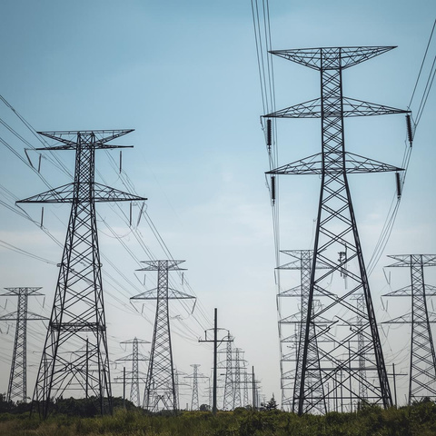
Existing Tools & Gaps
What they do well
Common Gap
Accurate measurement
Official emissions data
Real-time grid signals
No automated optimization
No execution
No verified proof of savings
Notes:
We looked at what exists. AWS and Google both have carbon dashboards — they show
you your emissions from last month. Thoughtworks built an open-source version that
works across all three clouds. Electricity Maps gives you real-time data on which
regions are clean right now.
They all measure. Some suggest. But none of them actually *move your workloads*.
And none of them *verify* that the savings were real after the fact. That's the gap —
the jump from 'here's your number' to 'here's what we did about it, and here's proof
it worked.'"

Slide 5
Literature → Design Logic
From Research to Design Decisions
Findings
Design Implications
Load shifting reduces carbon 10–40 (Radovanović et al., 2022)
Carbon-only optimization causes cost/SLA risk (Hanafy et al., 2023)
Multi-agent systems outperform monoliths (Wu et al., 2023)
Carbon accounting requires uncertainty reporting (GHG Protocol)
→ Region + time shifting as core lever
→ Hard constraints on cost + SLA
→ Specialized agents (Planner, Executor, Verifier)
→ Confidence intervals on every emission claim
Notes:
"[Person 1]: Google published a paper showing they reduced data center carbon by
10 to 40% just by shifting when and where jobs run. But they never published
*how to verify those numbers*. That's what pushed us toward building verification first.
[Person 2]: Another paper showed that if you only optimize for carbon and ignore
cost, cloud bills spike unpredictably. So our system has hard constraints — it
will never recommend something that violates SLAs or blows up costs.
[Person 3]: The AutoGen paper from Microsoft showed that multi-agent systems with
specialized roles outperform single-model approaches for complex tasks. So instead
of one big AI, we built five agents that each do one thing well.
[Person 4]: The GHG Protocol — the actual global standard for carbon accounting —
requires you to report uncertainty. Most tools just give point estimates. Ours gives
confidence intervals on every number.
And here's the honest surprise that changed our design: at $75/ton, the carbon
cost is $28 on an $8,600 cloud bill. Less than 1%. The system's real value isn't
saving money — it's building the proof infrastructure companies will need when
regulators ask 'show us your reductions were real.'"

Slide 6
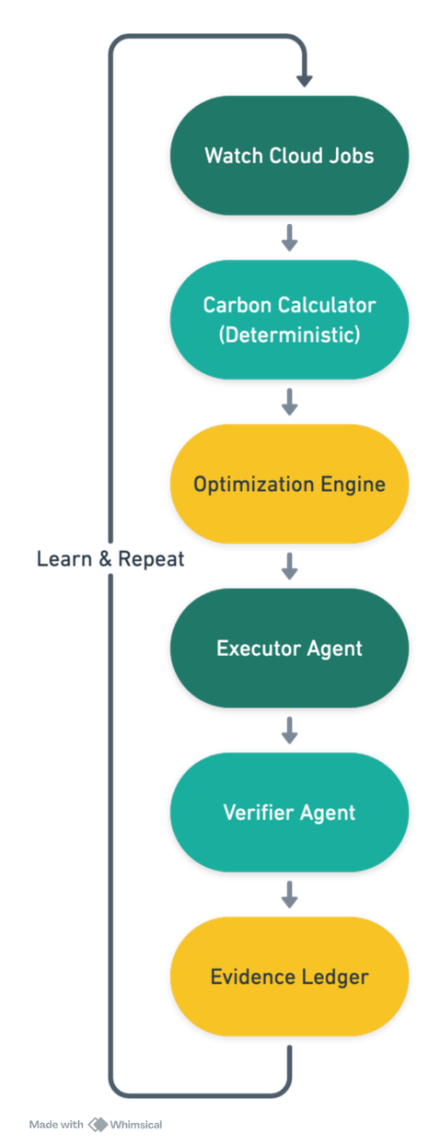

Initial Concept & System Loop
What makes us different?
✔ Measures emissions
✔ Automates optimization
✔ Executes changes
✔ Verifies savings using counterfactual analysis
Deterministic code:
✔ Emissions math
✔ Optimization
✔ Verification
Notes:
"Here's what we're actually building. A loop: watch cloud jobs, calculate their
carbon, find cleaner options, move the job, and then — this is the key part —
*prove it worked* using counterfactual analysis. What would have happened if we
hadn't moved it? Compare that to what actually happened. That's your verified saving.
The difference from existing tools is that bottom row. Nobody verifies. We do.
And the AI question — we use LLM agents for the things LLMs are good at: explaining
*why* a recommendation matters, writing Jira tickets that developers will actually
read, assessing risk in context. But the math — emissions, optimization, verification —
is deterministic. No LLM touches a number. That's deliberate: if an auditor asks
'where did 42.7 kgCO₂ come from?', the answer is a formula, not 'GPT said so.’”

Slide 7


Milestones & Risk
Validation Plan & Risks
Already Built
Checkpoint 2
Biggest Risk
Prototype simulating 24,000+ jobs
16% carbon reduction
Zero SLA violations
Verified evidence chain
Integrate real LLM
Stress-test failure modes
Sensitivity analysis on carbon pricing
Counterfactual validity
Ensuring claimed reductions reflect real-world impact.
Sources wood only from sustainable forests.
Notes:
"We already have a working prototype — not just a plan. It simulates 24,000 cloud
jobs, optimizes them, and verifies every reduction. 16.6% carbon reduction, cost
actually went down slightly, zero SLA violations.
For Checkpoint 2: connect to a real LLM, stress-test our failure modes, and run
sensitivity analysis across different carbon prices.
Biggest risk we're honest about: counterfactual validity. We compute 'what would
have happened' — but real-world confounders could distort that. Testing that
rigorously is our CP2 priority.
Thank you. Happy to take questions."

Slide 8

Thank You

